Slide 1
ME759 High Performance Computing for Applications in Engineering [Spring 2020]
Lecture 09
02/10/2019
Dan Negrut, 2020 ME759 UW-Madison

Slide 2
Quote of the day
“Keep away from people who try to belittle your ambitions. Small people always do that, but the really great make you feel that you, too, can become great.”
-- Mark Twain, American writer, humorist, entrepreneur, publisher, and lecturer [1835 - 1910].

Slide 3
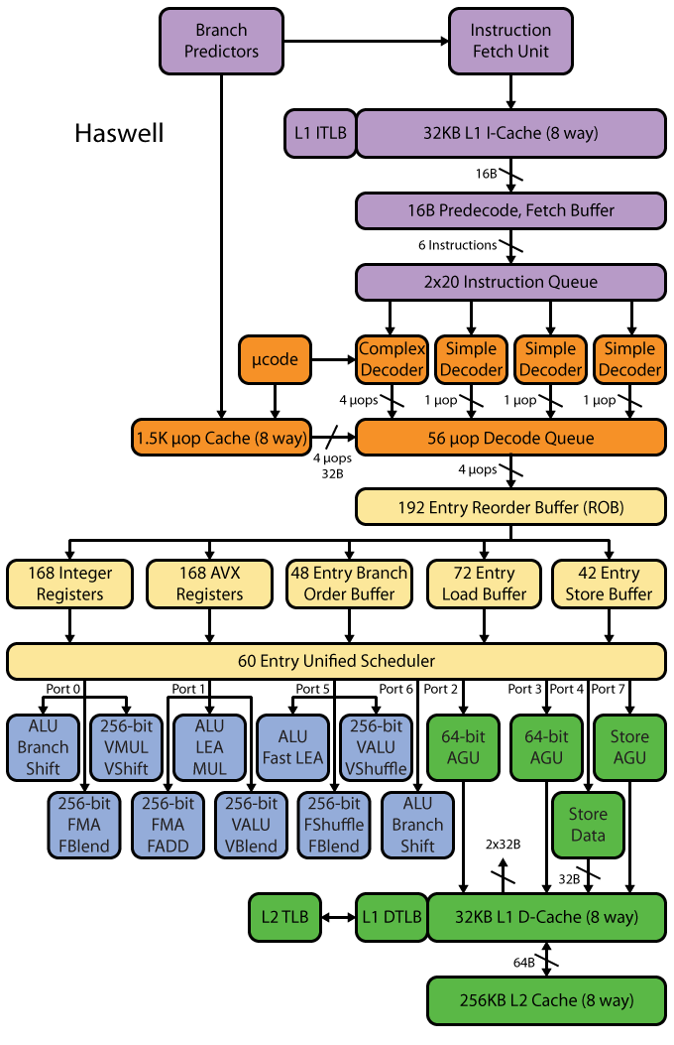
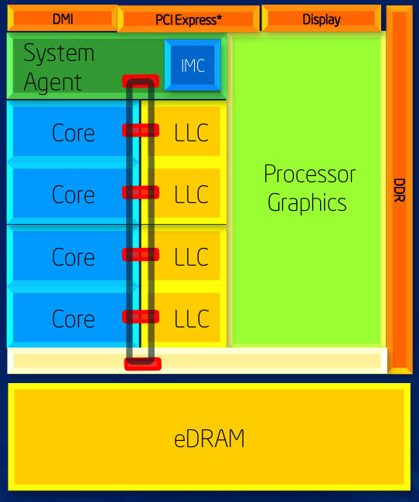
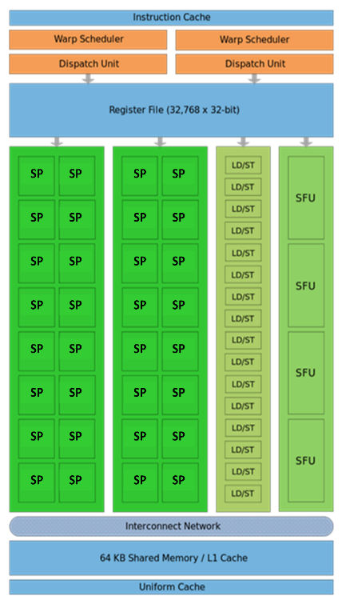
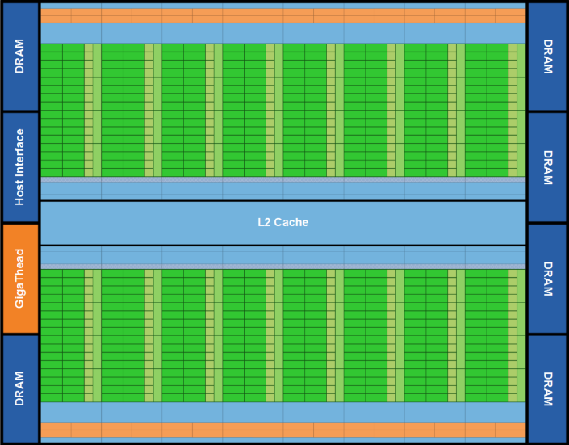
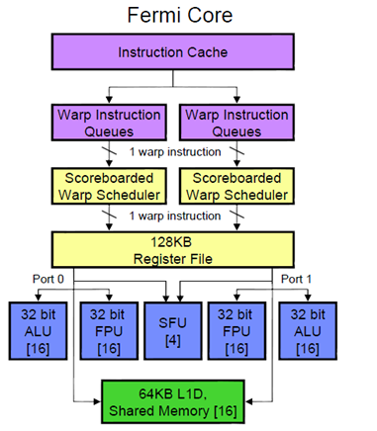
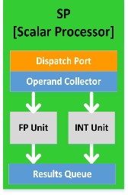
Before we get going…
Last time:
Sequential computing gains – little hope left owing to:
Memory wall
Power wall
ILP wall
Improving the speed of your computation will require parallel computing
The “two oxen vs. 512 chicken” analogy
Today
The basics of GPU computing
Other tidbits:
Assigned reading (syllabus gets updated)
Assignment due on Th at 9 pm
No class on Friday – Dan out of town

Slide 4
GPU Computing with CUDA

Slide 5
The long view
Goal: Understand how GPUs can be used in Scientific Computing
Topics
Hardware considerations
“Hello World” with GPU computing
Execution configuration issues
The memory model in CUDA
Scheduling issues in CUDA
Occupancy and optimization issues
Notes:
It’s fast for a variety of jobs Really good for data parallelism (another way of saying SIMD)
It’s cheap to get one ($120 to $480) High end GPUs for Scientific Computing are more like $7000
GPUs are everywhere Chances are you have one or at least have easy access to one

Slide 6
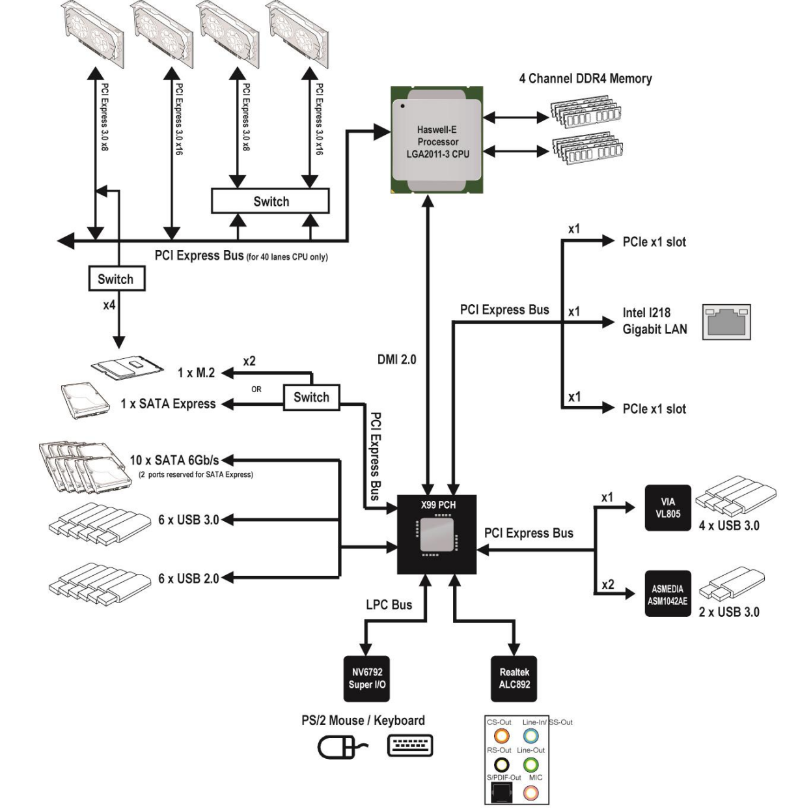
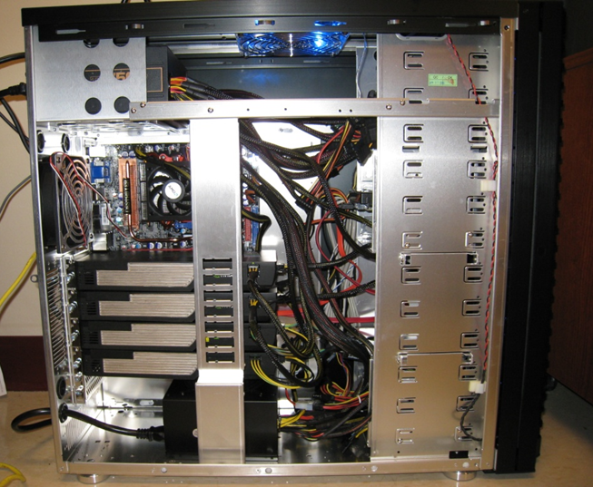
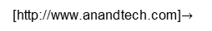
Typical Hardware Architecture
GPU w/ local DRAM
(the “device”)
CPU
(the “host”)
[http://www.anandtech.com]$→$
Notes:
thbridge now absorbed in CPU (the chipset).
GPUs also called accelerators or co-processors (complement the CPU).
The GPU connected through the PCIe bus
In PCIe 1.1 (currently the most common version) each lane sends information at a rate of 250 MB/s (250 million bytes per second) in each direction. PCIe 2.0 doubles this data rate, introduced in late 2007, PCIe 2.0 is found on newer systems such as those based around the Intel X38 or AMD 780G chipsets. The latest proposed PCIe 3.0 standard will increase the speed of the links further (tentatively scheduled for release around 2010).[1]
Each PCIe slot carries either one, two, four, eight, sixteen or thirty-two lanes of data between the motherboard and the addin card. Lane counts are written with an "x" prefix e.g. x1 for a single-lane card and x16 for a sixteen-lane card. Thirty-two lanes of 250 MB/s (PCIe 1.1) gives a maximum transfer rate of 8 GB/s (250 MB/s x 32, i.e., 8 billion bytes per second) in each direction. However the largest size in common use for PCIe 1.1 is x16, giving a transfer rate of 4 GB/s (250 MB/s x 16) in each direction. Putting this into perspective, a single lane for PCIe 1.1 has nearly twice the data rate of normal PCI, a four-lane slot has a transfer rate comparable to the fastest version of the old parallel PCI-X 1.0, and an eight-lane slot has a transfer rate comparable to the fastest version of AGP. However the data rates cited must be derated because 8b/10b coding is used in the physical layer. The link transfer speeds cited are to be considered maximum theoretical data rates.
PCIe slots come in a variety of physically different sizes referred to by the maximum lane count they support, ie. x1, x2, x4, x8, x16 and x32. A PCIe card will fit into a slot of its size or bigger, but not into a smaller PCIe slot.

Slide 7
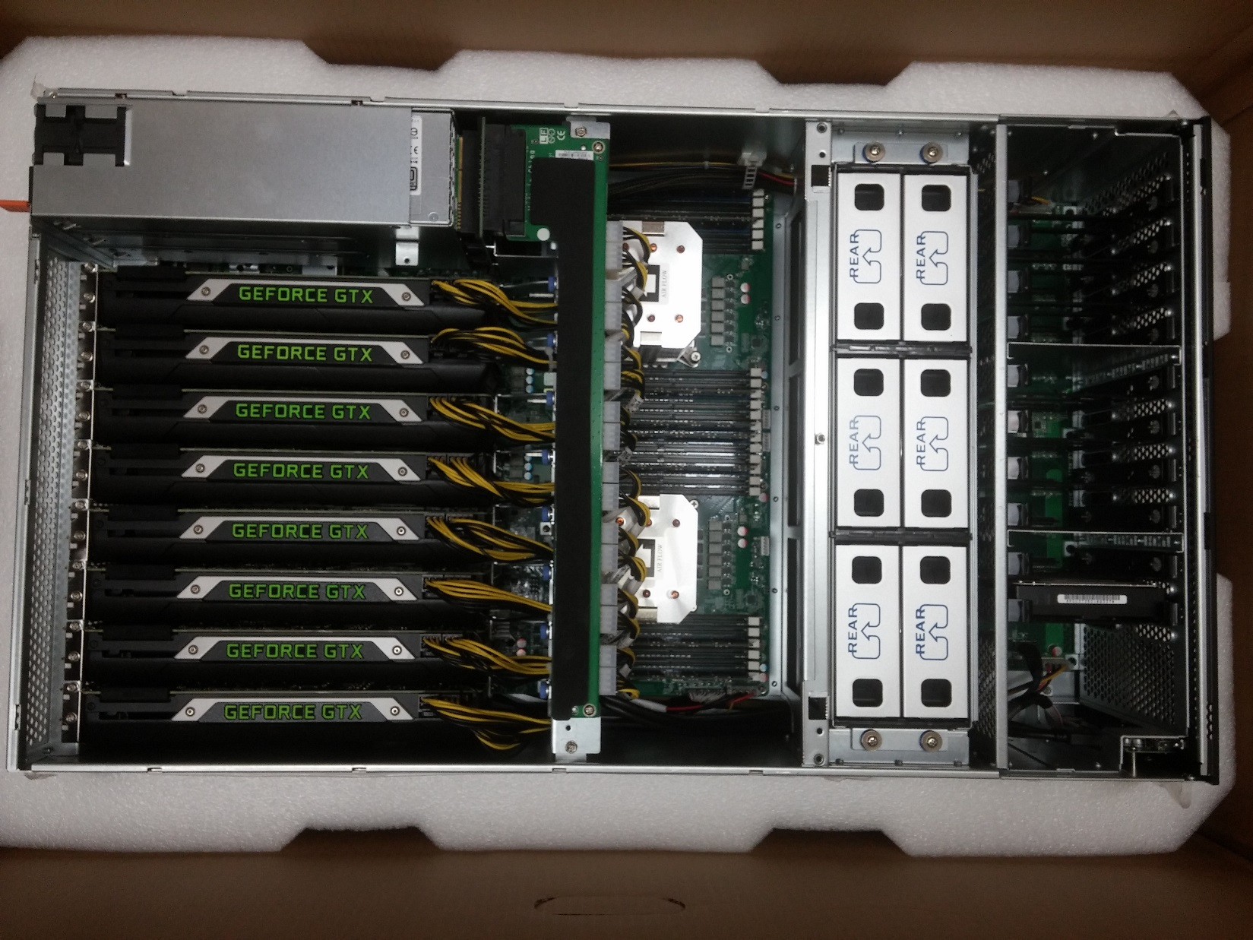
Euler Node, 2015 Vintage

Slide 8
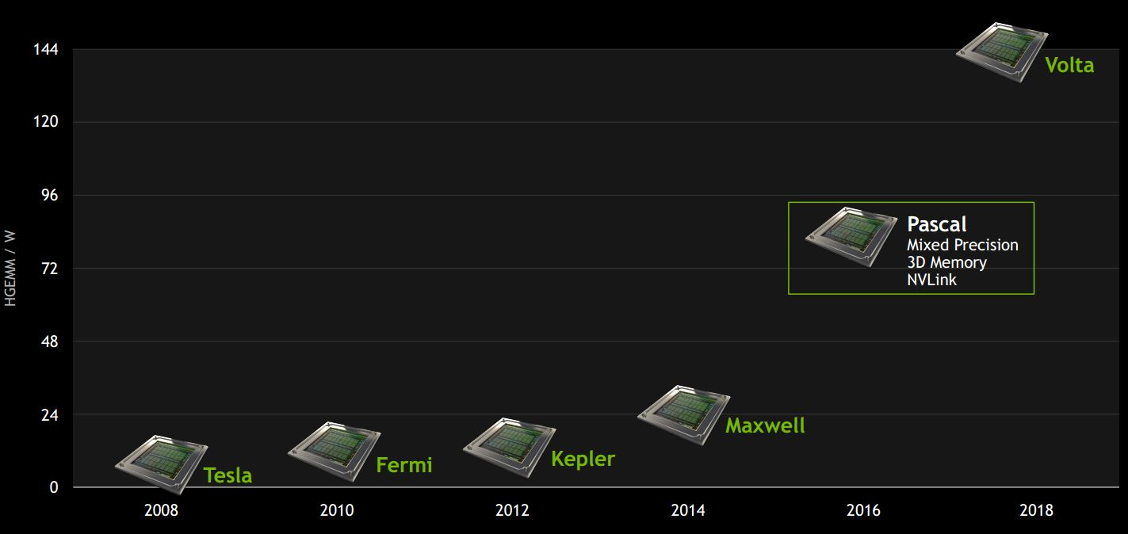
NVIDIA GPU Roadmap
Latest architecture for scientific computing: Volta
Notes:
Next (2018): Volta

Slide 9
GPU computing: eager to accommodate Machine Learning needs

Slide 10

Fermi: High-level Perspective
Lots of ALU (green), not much of CU (orange)
Explains why GPUs are fast for high arithmetic intensity applications
Arithmetic intensity: high when many operations performed per word of memory access
Notes:
How else could you organize 3 billion (today 7 billion) transistors?
Specialize the hardware. Organize it into a bunch of Streaming Multiprocessors and dedicate most transistors to number crunching (ALUs)

Slide 11
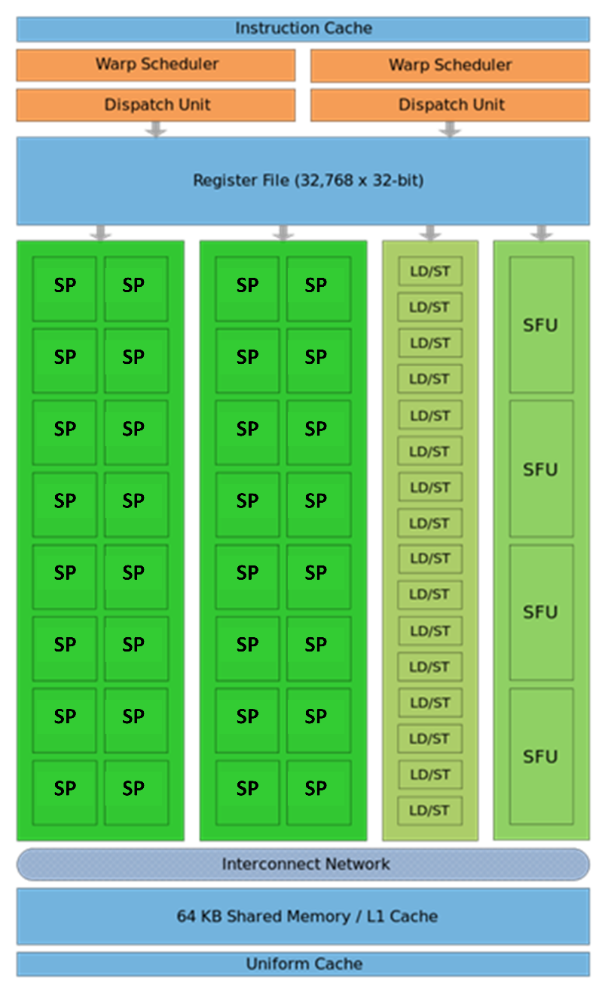
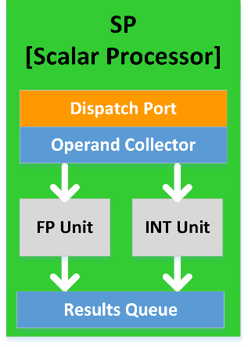
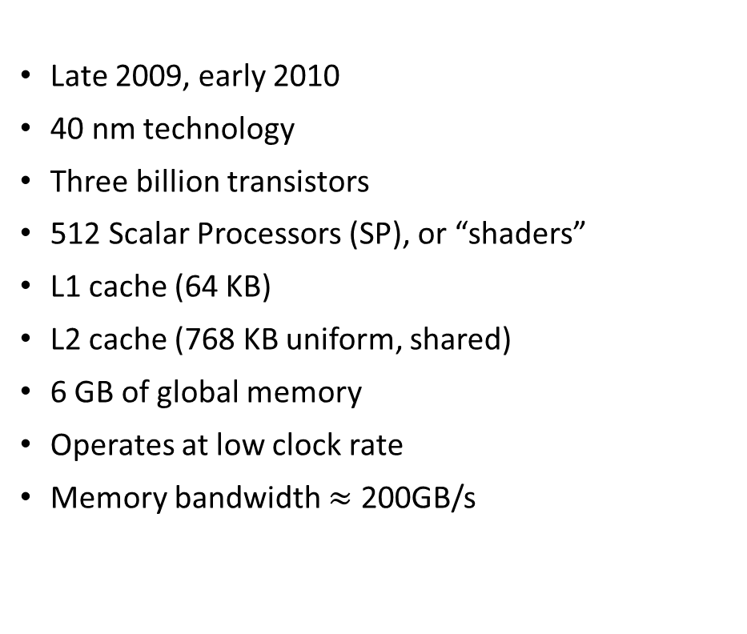
The Fermi Architecture
Late 2009, early 2010
40 nm technology
Three billion transistors
512 Scalar Processors (SP), or “shaders”
L1 cache (64 KB)
L2 cache (768 KB uniform, shared)
6 GB of global memory
Operates at low clock rate
Memory bandwidth $≈$ 200GB/s
Notes:
An SM is the quantum of scalability on a GPU. More $ → more SMs
Think of an SM as a single core on a CPU (do not buy into NVIDIA’s marketing)
Why is this important? Think of launching a job with 1 million threads. The more SMs you have, the more SPs…
512= 16 x 32
Components:
16+16 = 32 SPs
16 load/store units
4 SFU (for special functions)
2 warp schedulers
Several clock rates:
Shaders (SPs)
Scheduler: ½ the frequency of the SPs
Memory: own rate

Slide 12
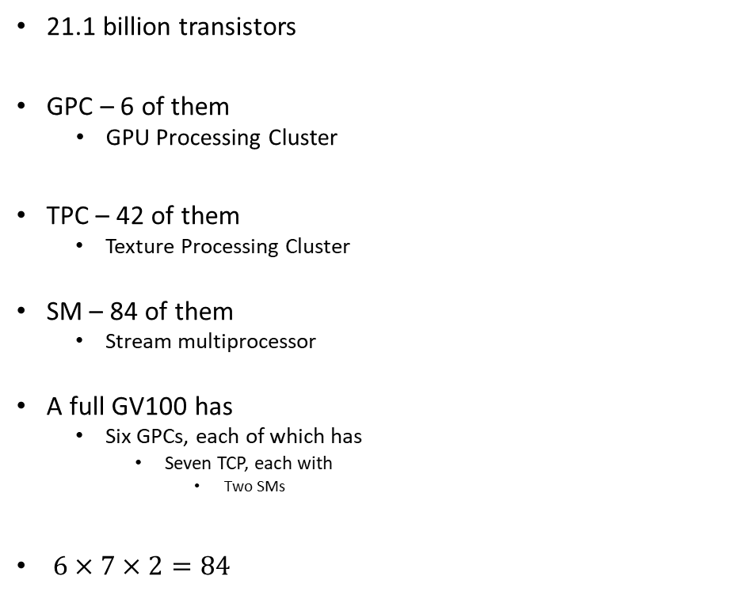
NVIDIA Volta GV100: microarchitecture schematic and nomenclature
21.1 billion transistors
GPC – 6 of them
GPU Processing Cluster
TPC – 42 of them
Texture Processing Cluster
SM – 84 of them
Stream multiprocessor
A full GV100 has
Six GPCs, each of which has
Seven TCP, each with
Two SMs
$6×7×2=84$
Notes:
A full GV100 GPU has a total of:
5376 FP32 cores
5376 INT32 cores
2688 FP64 cores
672 Tensor Cores
336 texture units

Slide 13
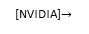
NVIDIA Volta GV100: microarchitecture schematic and nomenclature
Each SM has
64 FP32 scalar processors (SPs)
64 INT32 scalar processors (SPs)
32 FP64 scalar processors (SPs)
8 Tensor scalar processors (SPs)
Four texture units
It’s own L0 Instruction Cache
A wrap scheduler
A Dispatch unit
16,384 registers
[NVIDIA]$→$

Slide 14

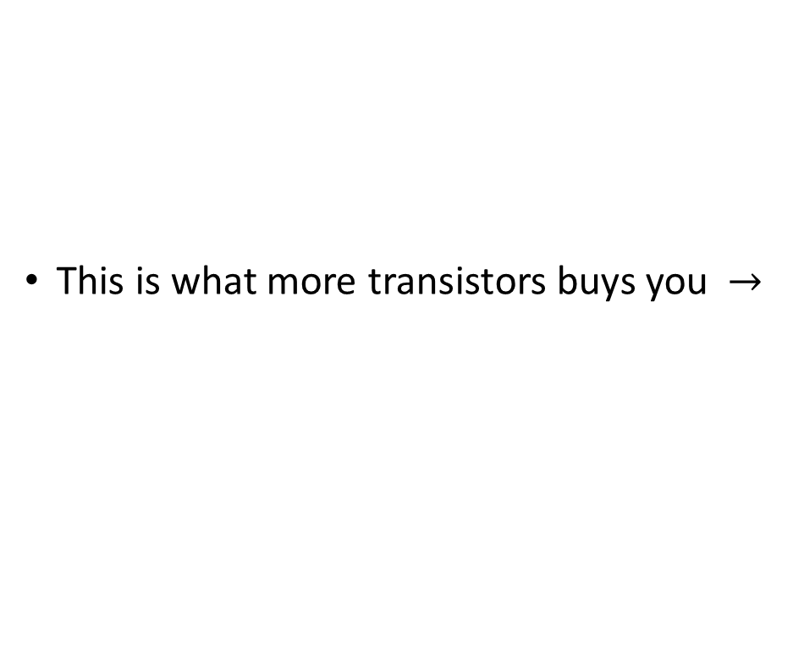
Performance overview, last four NVIDIA GPU generations
This is what more transistors buys you $→$
[NVIDIA]$→$

Slide 15
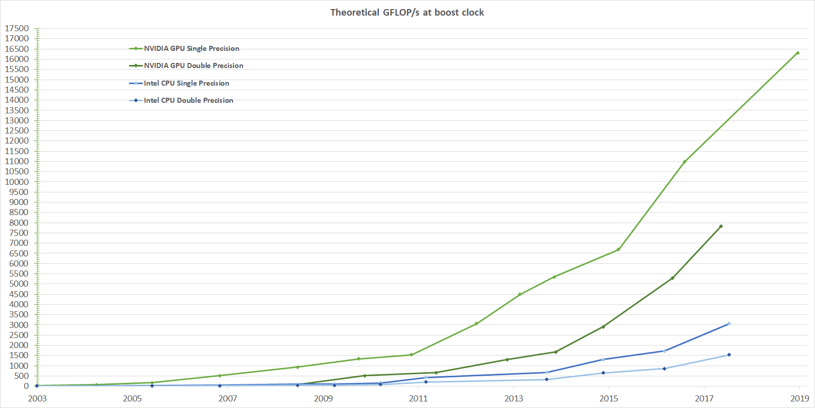
Theoretical GFLOP/s
[NVIDIA]$→$
Notes:
Xeon E7-8800 v4: 0.844 TFLOPS

Slide 16
High Speed Requires High Bandwidth
Assume that you want to add two arrays and reach 1 Tflops: 1E12 ops/second
You need to fetch/feed 2E12 operands per second…
Assume each number is stored using 4 bytes (float or integer)
You need to fetch 2E12*4 bytes in a second. This is 8E12 B/s, which is 8 TB/s…
You haven’t taken into account that you probably want to send back the outcome of the operation that you carry out
The global memory bandwidth on the GPU is in the neighborhood of 1 TB/s (1000 GB/s)
About 8 times less than what you need
Conclusion: you need data in cache, global memory can’t sustain 1 Tflops
Notes:
The solution is to keep data in registers (more about this later)
The bandwidth of accessing data from registers is exactly around 8 TB/s.
Here’s a set of rules that you need to keep in mind before going further…
Get the data on the GPU and keep it there
Give the GPU enough work to do (High arithmetic intensity)
Focus on data reuse within the GPU to avoid memory bandwidth limitations

Slide 17
Bandwidth in a CPU-GPU System
Latency:
Low
GPU SMs
CPU Core
Cache L1: 32 KB
L2: 256 KB
L3: 45 MB (shared)
80GB/s
NOTE: The width of the black lines is proportional to the bandwidth.
50-100
GB/s
900
GB/s
Latency:
Medium Low
Latency:
Rel.Low
System Memory
(256 GB)
GPU Memory
(32 GB)
Infiniband to Next Node
8-16 GB/s
6GB/s
Latency:
High
[4-6 us]
Latency:
Medium
17
Notes:
17
Hammad – GPU numbers are for a Pascal P100, PCI numbers are for PCIe3
Infiniband is assuming mellanox results from here: http://www.mellanox.com/page/performance_infiniband
CPU memory numbers are for a E7 8890v3 http://ark.intel.com/products/84685/Intel-Xeon-Processor-E7-8890-v3-45M-Cache-2_50-GHz
CPU cache numbers are an average between expected L1 and L3 cache performance (not exact but approximate)

Slide 18
Info on Previous Slide
GPU numbers are for an NVIDIA Pascal V100
PCI numbers are for PCIe3
Infiniband is assuming Mellanox results from here
CPU memory numbers are for a E7 8890v3, 2.5GHz, 45MB L3
CPU cache numbers: an average between expected L1 and L3 speed
Not exact, but approximate

Slide 19
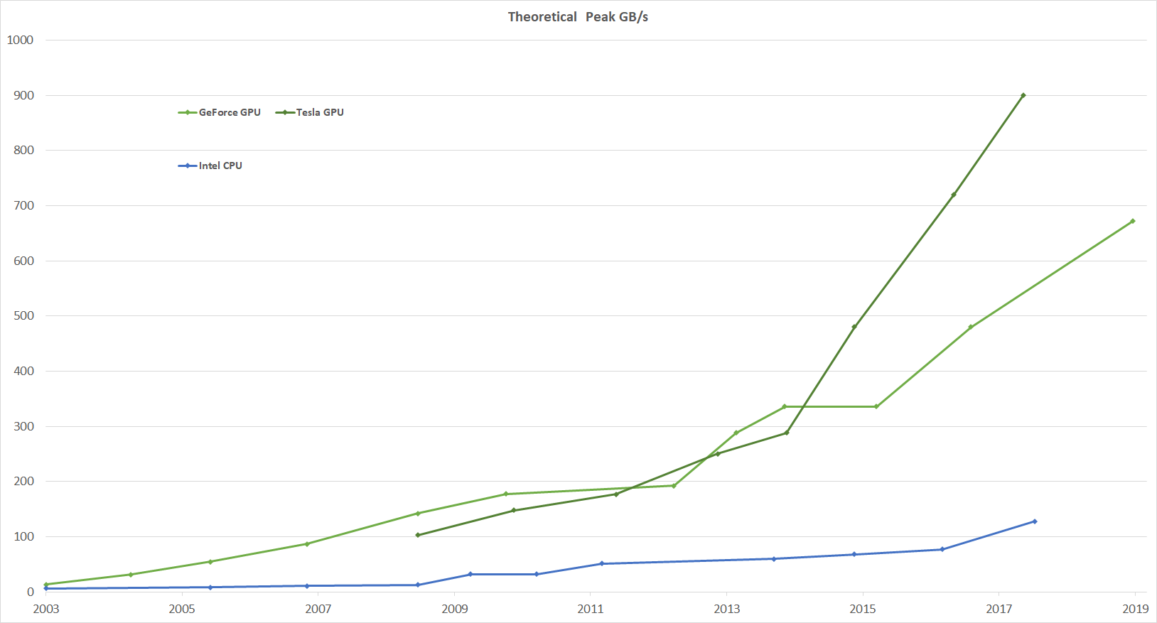
Bandwidths, GPU computing w/ NVIDIA
[NVIDIA]$→$
Notes:
If you look at flop rates GPU/CPU, also about 5 (roughly like the bandwidth ratio)
Take away message: you can expect a speedup of 2-10 if moving to GPU. Do not expect 100x
Tesla P100 (Pascal): 720 GB/s (stacked memory) → short detour

Slide 20
Speed-ups, GPU Computing: What’s reasonable to expect?
Since you have higher bandwidth on a GPU, it is likely that your code will run faster on the right problem
How much faster?
Compare the bandwidth/latency of mem accesses on GPU and CPU
Ball park: 4-5X speedup
Other things might come into play
Caches and cache size, for instance
The very nature of the problem you’re trying to solve
Good for data parallelism, fine grain parallelism

Slide 21
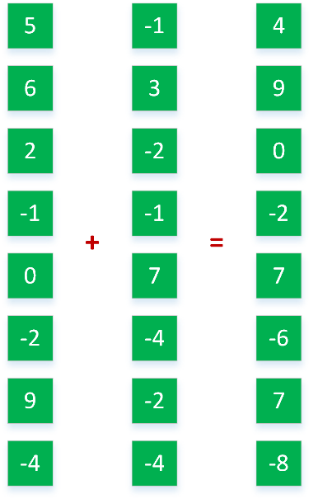
Coarse Grain vs. Fine Grain Parallelism
#pragma omp parallel sections
{
#pragma omp section
a = alice();
#pragma omp section
b = bob();
#pragma omp section
k = kate();
}
double s = boss(a, b);
double result = bigboss(s,k);
Fine Grain
Coarse Grain
alice
bob
[IOMPP]→
Control
ALU
ALU
boss
kate
GPU
ALU
ALU
CPU
Cache
bigboss
DRAM
DRAM

Slide 22
Coarse Grain vs. Fine Grain Parallelism
Coarse grain parallelism (good for CPUs)
Few tasks
Tasks are heterogeneous
Tasks are in general complex, lots of control flow
Example: baking a cake, making coffee, broiling fish – all at the same time
Fine grain parallelism (very good for GPU, ok for CPU)
Many, many tasks
Tasks are basically identical
Tasks are in general pretty straightforward, lots of math, not much control flow
Example application: image processing – lots of pixels to deal with

Slide 23
GPGPU Computing: when started, why started
GPGPU: General Purpose GPU Computing
Done in early 2000s using graphics libraries
Why was GPGPU attractive?
GPUs had high bandwidths
Something dampening our enthusiasm: data needs to be moved into the GPU to process it
8-16 GB/s is typical today (PCIe)
NVLink: 5-12 times faster than PCIe 3
Notes:
People realized quickly that GPUs can be used for more, beyond graphics.
GPGPU – first utilization of GPUs for General Purpose.
The idea was to “hijack” shader programs to make them do other useful computations
very awkward and difficult
limited (e.g. communication limited between pixels: only gather, but no scatter – could only write to 1 pixel, no support for integer arithmetic)

Slide 24
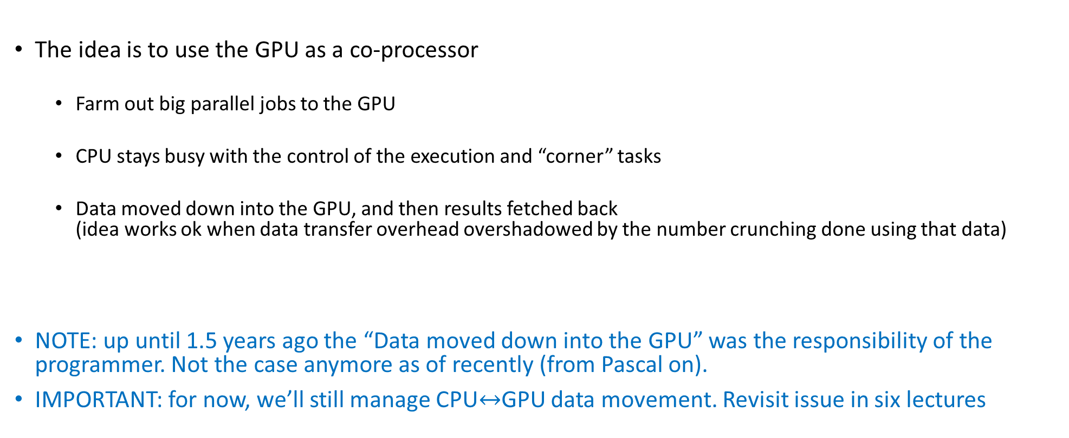
GPGPU Computing: how carried out
The idea is to use the GPU as a co-processor
Farm out big parallel jobs to the GPU
CPU stays busy with the control of the execution and “corner” tasks
Data moved down into the GPU, and then results fetched back (idea works ok when data transfer overhead overshadowed by the number crunching done using that data)
NOTE: up until 1.5 years ago the “Data moved down into the GPU” was the responsibility of the programmer. Not the case anymore as of recently (from Pascal on).
IMPORTANT: for now, we’ll still manage CPU$↔$GPU data movement. Revisit issue in six lectures
Notes:
People realized quickly that GPUs can be used for more, beyond graphics.
GPGPU – first utilization of GPUs for General Purpose.
The idea was to “hijack” shader programs to make them do other useful computations
very awkward and difficult
limited (e.g. communication limited between pixels: only gather, but no scatter – could only write to 1 pixel, no support for integer arithmetic)

Slide 25
CUDA: Making the GPU Tick…
“Compute Unified Device Architecture” – freely distributed by NVIDIA
When introduced (in 2006) it eliminated the graphics-constraints associated with GPGPU
CUDA enables a general purpose programming model
User kicks off batches of threads on the GPU to execute a function (kernel)
Targeted software stack
Scientific computing oriented drivers, language, and tools
Interface designed for compute (i.e., graphics-free API)
Explicit GPU memory management
Notes:
NVIDIA introduced CUDA (2006) to make the GPU programmable

Slide 26
CUDA Programming Model: GPU as a Highly Multithreaded Coprocessor
The GPU is viewed as a compute device that:
Is a co-processor to the CPU or host
Has its own memory (device memory, in CUDA parlance)
Runs many threads in parallel
Data-parallel portions of an app. run on the device as kernels executed in parallel by many threads
Differences between GPU and CPU threads
GPU threads are extremely lightweight
Very little creation overhead
GPU needs 1000s of threads for full efficiency
Multi-core CPU needs only a few heavy ones
Notes:
The model is:
host copies data to device
host launches a computation (kernel) on the device
host copies back data from device

Slide 27
Compute Capability [of a Device] vs. CUDA Version
“Compute Capability of a Device” refers to hardware
Defined by a major revision number and a minor revision number
Example:
Tesla C1060 is compute capability 1.3
Fermi architecture is capability 2
Kepler architecture is capability 3
Maxwell architecture is capability 5
Pascal architecture is capability 6 (available on Euler)
Turing and Volta are compute capability 7 (available on Euler)
A higher compute capability indicates an more able piece of hardware
The “CUDA Version” indicates what version of the software you are using to run on the hardware
In a perfect world
You would run the most recent CUDA (version 10.2) software release
You would use the most recent architecture (compute capability 7.0)
Notes:
Tesla V100: compute capability 7.0

Slide 28
NVIDIA Compute Capability

Slide 29
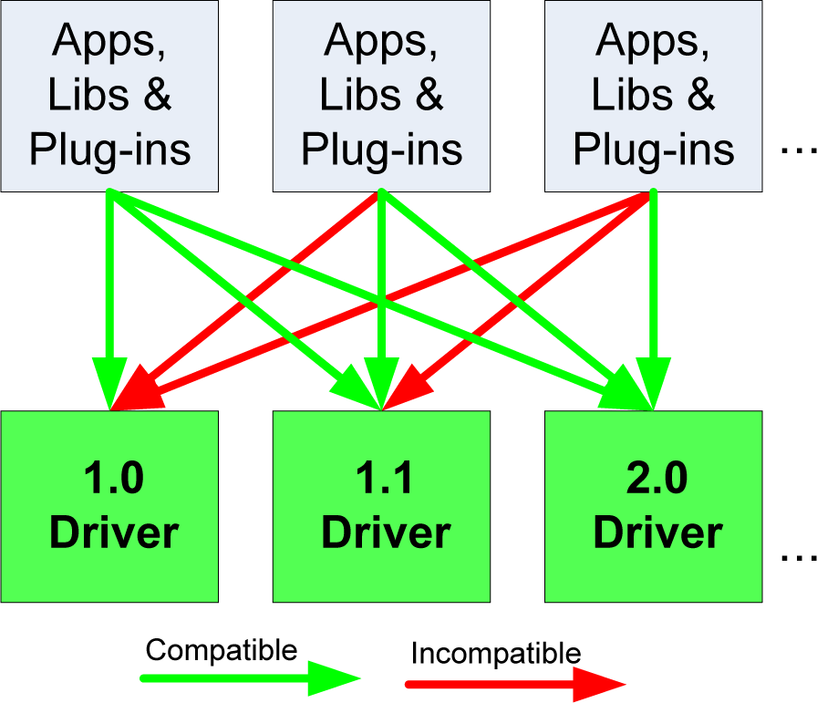
Compatibility Issues, software-wise
The basic rule: the CUDA Driver API is backward, but not forward compatible
The functionality in later versions increased, was not there in previous versions
Code you ran ok w/ CUDA 5.0 will work w/ CUDA 10.0 as well
Not the other way around though
Notes:
You cannot run code for capability 2.0 on hardware 1.0 (e.g. double precision support was only added in capability 2.0)

Slide 30
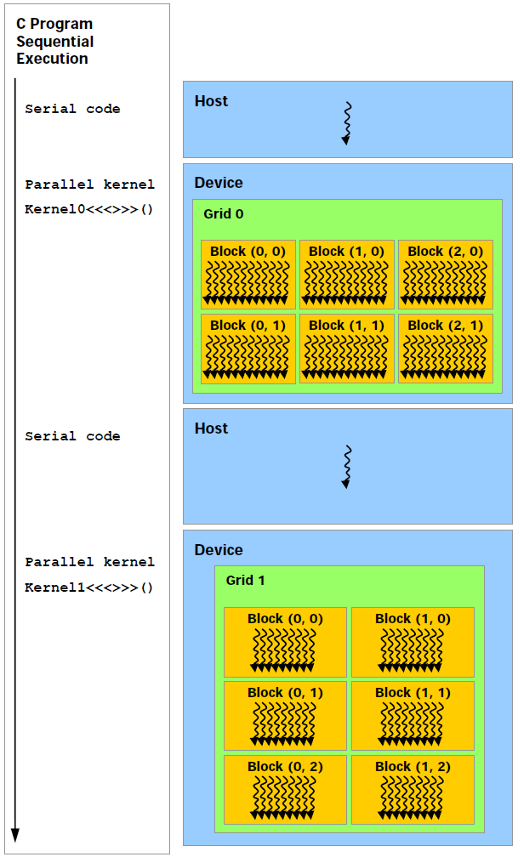
The CUDA Execution Model
Execution of Kernel0
Execution of Kernel1
This is how your C code looks like
This is how the code gets executed on the hardware in heterogeneous computing. GPU calls are asynchronous…
Notes:
NOTE: Execution on the GPU is ORDERED!
You can COUNT on this + global memory PERSISTENT → split work in multiple kernels.
Asynchronous: Important because you can do useful work on the CPU while the GPU works
Beware of this when timing kernel execution – see later
If you really need to make the CPU wait for the GPU, use cudaDeviceSynchronize(), which enforces the CPU to wait until all preceding commands in all streams of all host threads have completed.
Copying data from device back to host is a synchronization point in that stream: cudaMemcpy is synchronous.
There are asynchronous versions of cudaMemcpy

Slide 31
The CUDA Execution Model
Data needs to be copied into GPU device memory and the results need to be fetched back
This happens over a PCI-Express 3.0 connection
Can also happen over NVLink (5-12 times faster than PCI-E)
NVLink: Available on one Euler node only
IMPORTANT:
For GPU computing to pay off, the data transfer overhead should be overshadowed by the GPU number crunching that draws on that data
The CUDA kernel calls and copying to/from GPU are managed by the CUDA runtime in a separate stream associated w/ the GPU execution
Notes:
The GPU has actually 3 engines which can be used simultaneously.
We will not get into this more advanced topic (streams)
GPU cards support multiple streams so that you can execute in a stream and copy data in another stream. The streams are independent, so you must explicitly synchronize. Working with a single stream (0), synchronization at copying time is automatic.

Slide 32
The CUDA Execution Model: Three Opportunities for Asynchronous Execution
The GPU and CPU work in asynchronous mode
The CPU moves on right away after a kernel launch
The GPU works at the same time the CPU works
Another level of asynchronicity: the GPU has three engines that can work at the same time
copy-in engine + copy-out engine + execution engine
More later (when we talk about streams)
Another level of asynchronicity yet: Multiple GPUs can work at the same time on one host
Notes:
The GPU has actually 3 engines which can be used simultaneously.
We will not get into this more advanced topic (streams)
GPU cards support multiple streams so that you can execute in a stream and copy data in another stream. The streams are independent, so you must explicitly synchronize. Working with a single stream (0), synchronization at copying time is automatic.

Slide 33
Languages Supported in CUDA
CUDA: very good friends with C
Yet minor extensions are needed to flag the fact that a function actually represents a kernel, that there are functions that will only run on the device, etc.
You end up working in “C with extensions”
FOTRAN is supported
There is [growing] support for C++ programming (operator overload, lambda functions, etc.)
Notes:
C++ support for templates as well
PGI (acquired by NVIDIA) provides FORTRAN support

Slide 34
The CUDA-enabled ecosystem for GPU Computing
[NVIDIA]→

Slide 35
The NVIDIA CUDA-enabled hardware
Remarks:
There is no CC of gen 4
Fermi was CC 2
The name “Tesla” used for high-end GPUs for non-graphics apps
[NVIDIA]→

Slide 36
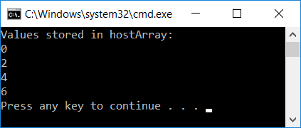
CUDA, First Example
#include<cuda.h>
#include<iostream>
__global__ void simpleKernel(int* data)
{
//this adds a value to a variable stored in global memory
data[threadIdx.x] += 2*(blockIdx.x + threadIdx.x);
}
int main()
{
const int numElems = 4;
int hostArray[numElems], *devArray;
//allocate memory on the device (GPU); zero out all entries in this device array
cudaMalloc((void**)&devArray, sizeof(int) * numElems);
cudaMemset(devArray, 0, numElems * sizeof(int));
//invoke GPU kernel, with one block that has four threads
simpleKernel<<<1,numElems>>>(devArray);
//bring the result back from the GPU into the hostArray
cudaMemcpy(&hostArray, devArray, sizeof(int) * numElems, cudaMemcpyDeviceToHost);
//print out the result to confirm that things are looking good
std::cout << "Values stored in hostArray: " << std::endl;
for (int i = 0; i < numElems; i++)
std::cout << hostArray[i] << std::endl;
//release the memory allocated on the GPU
cudaFree(devArray);
return 0;
}
Notes:
Shows the main elements of CUDA programming (80/20 rule)
Explain:
__global__
cudaMalloc
kernel execution configuration
cudaMemcpy
nvcc looks for such keywords and separates code that is supposed to run on CPU and GPU

Slide 37
CUDA Function Declarations: (the “C with extensions” part)
 | Executed on the: | Only callable from the:
__device__ float myDeviceFunc() | device | device
__global__ void myKernelFunc() | device | host
__host__ float myHostFunc() | host | host
__global__ defines a kernel function, launched by host, executed on the device
Must return void
NOTE: can combine __device__ with __host__
See CUDA Reference Manual http://docs.nvidia.com/cuda/cuda-c-programming-guide/index.html
Notes:
Can combine: __device__ __host__

Slide 38
Following Up on our Example: Segue into the “Execution Configuration”
In our code, we invoked the kernel like this:
simpleKernel<<<1,4>>>(devArray)
What happens if we invoke the kernel like this:
simpleKernel<<<1,12>>>(devArray)
What happens if we invoke the kernel like this:
simpleKernel<<<2,4>>>(devArray)
Notes:
<<<1,12>>> : writing out of bound

Slide 39
GPU Execution Configuration

Slide 40
Review of Nomenclature
The HOST
This is your CPU executing the “master” thread
The DEVICE
This is the GPU card, connected to the HOST through a PCIe connection
The HOST (the master CPU thread) instructs the DEVICE to execute KERNEL
When launching a KERNEL, the HOST has to inform the DEVICE how many threads should each execute KERNEL
This is called “defining the execution configuration”

Slide 41
[New Topic] The concept of Execution Configuration
A kernel function must be called with an execution configuration:
__global__ void kernelFoo(...); // declaration
dim3 DimGrid(100, 50); // 2D grid structure, w/ total of 5000 thread blocks
dim3 DimBlock(4, 8, 8); // 3D block structure, with 256 threads per block
kernelFoo<<< DimGrid, DimBlock>>>(...your arg list comes here…);
Notes:
How many threads do you want to use?
Difference with an OpenMP parallel for loop (forward reference)
on CPU you typically use as many threads as (virtual) cores you have
on a GPU you launch many more threads than SPs!
if you have a loop with 1 million iterations, those will be divided into 8 chunks on CPU
on a GPU you launch 1 million threads
You must divide the threads into blocks → these are executed by one SM (quantum of GPU scalability)
Max. number threads / block = 1024

Slide 42
Example
The host call below instructs the GPU to execute the function (kernel) “foo” using 25,600 threads
Two arguments are passed down to each thread executing the kernel “foo”
foo<<<100, 256>>>(p_matrixD, p_vectorD);
In this execution configuration, the host instructs the device it is supposed to run 100 blocks each having 256 threads in it
The concept of block is important since it represents the entity that gets executed by an SM (stream multiprocessor)
Notes:
These 100 blocks will be distributed (by the GPU-level scheduler) onto the available SMs (max. 32 blocks resident on an SM)
Concept of block is important:
They are the unit that gets executed on an SM.
Also, only threads in a block can be synchronized.

Slide 43
Execution Configuration Constraints
There is a limitation on the number of blocks in a grid:
The grid of blocks can be organized as a 3D structure: max of 2³¹-1 by 65,535 by 65,535 grid of blocks
Threads in each block:
The threads can be organized as a 3D structure (x,y,z)
Maximum x- or y-dimension of a block is 1024
Maximum z-dimension of a block is 64
The maximum number of threads in each block is 1024
Notes:
Discuss 1-D, 2-D, 3-D configurations.
As of compute capability 5.x:
Maximum number of resident blocks per multiprocessor: 32
Maximum number of resident warps per multiprocessor: 64
Maximum number of resident threads per multiprocessor: 2048
Question: what do you do when you have more threads than possible? Launch multiple kernels!

Slide 44
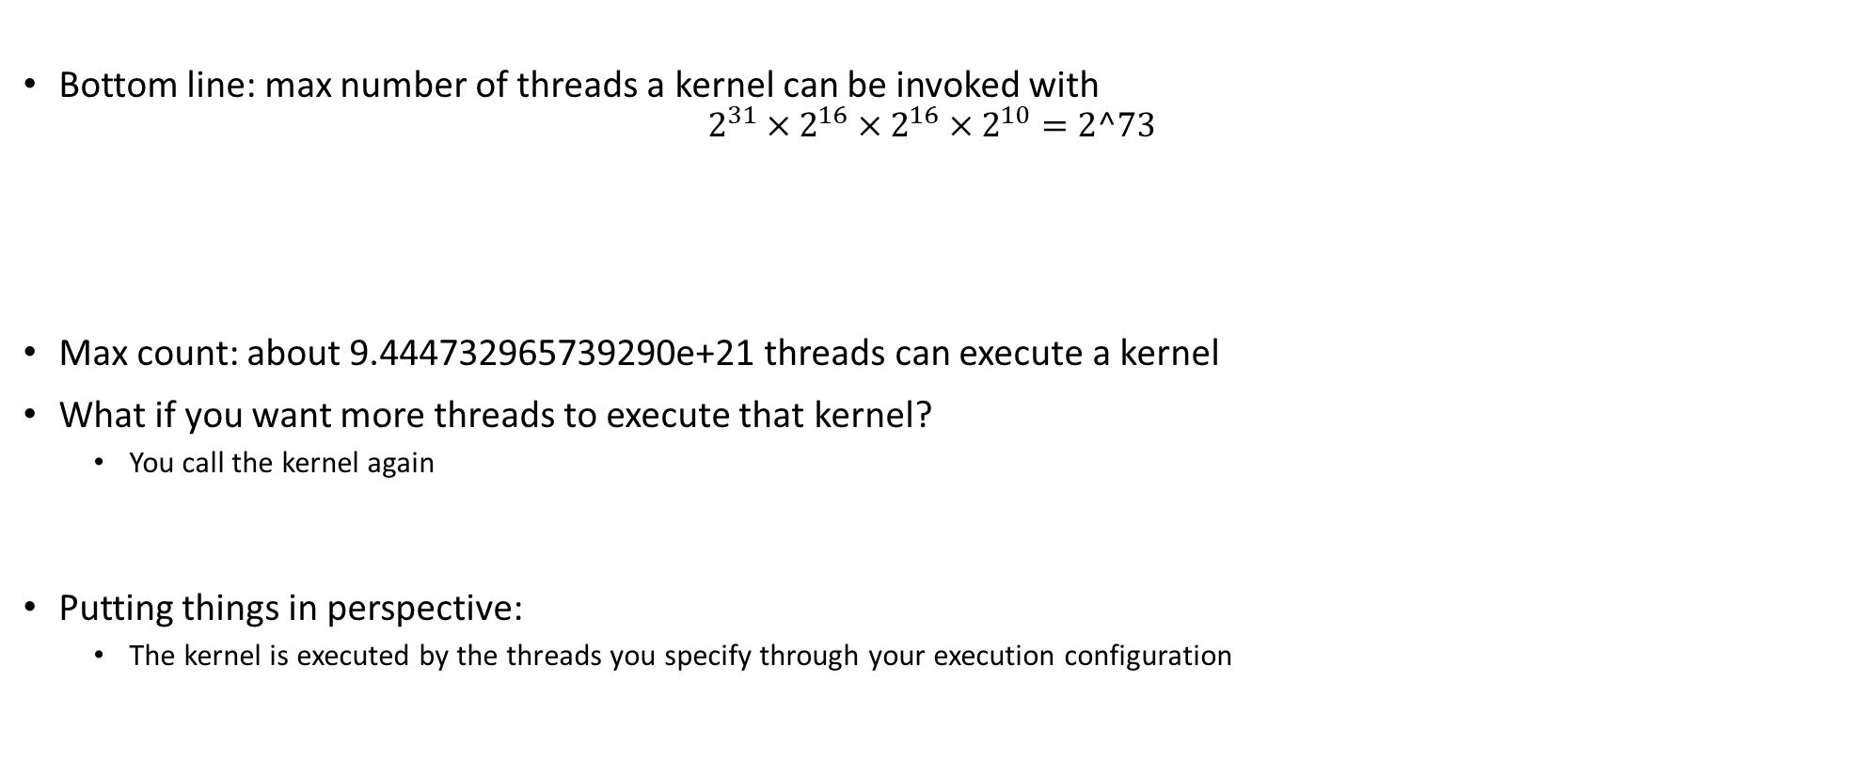
More on the Execution Configuration
Max number of threads in a block
Bottom line: max number of threads a kernel can be invoked with
$$2^{31}×2^{16}×2^{16}×2^{10}=2^73$$
Max count: about 9.444732965739290e+21 threads can execute a kernel
What if you want more threads to execute that kernel?
You call the kernel again
Putting things in perspective:
The kernel is executed by the threads you specify through your execution configuration
Max number of blocks in x-direction
Max number of blocks in z-direction
Max number of blocks in y-direction
Notes:
Discuss 1-D, 2-D, 3-D configurations.
As of compute capability 5.x:
Maximum number of resident blocks per multiprocessor: 32
Maximum number of resident warps per multiprocessor: 64
Maximum number of resident threads per multiprocessor: 2048
Question: what do you do when you have more threads than possible? Launch multiple kernels!

Slide 45
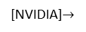
Block and Thread Index (Idx)
Threads and blocks have indices
Used by each thread the decide what data to work on (more later)
Block Index: a triplet of uint
Thread Index: a triplet of uint
Why this 3D layout?
Simplifies memory addressing when processing multidimensional data
Handling matrices
Solving PDEs on 3D subdomains
…
Device
Grid 1
Block
(0, 0)
Block
(1, 0)
Block
(2, 0)
Block
(0, 1)
Block
(1, 1)
Block
(2, 1)
Block (1, 1)
Thread
(0, 0)
Thread
(1, 0)
Thread
(2, 0)
Thread
(3, 0)
Thread
(4, 0)
Thread
(0, 1)
Thread
(1, 1)
Thread
(2, 1)
Thread
(3, 1)
Thread
(4, 1)
[NVIDIA]$→$
Thread
(0, 2)
Thread
(1, 2)
Thread
(2, 2)
Thread
(3, 2)
Thread
(4, 2)
Notes:
A block is a collection of threads that can cooperate with each other by:
Synchronizing their execution
Efficiently sharing data through a low-latency shared memory
Each thread must know what piece of data it’s working on → must be able to “differentiate” itself from other threads in the same block or in a different block
Exercise:
How was the grid defined here (how many dimensions, how many blocks in each direction)?
How was a block defined?

Slide 46
A Couple of Built-In Variables [Critical in supporting the SIMD parallel computing paradigm]
Each thread can find out the grid and block dimensions and its block index and thread index
This info used to figure out what work the thread needs to do
Each thread when executing a kernel has access to the following read-only built-in variables
threadIdx (uint3) – contains the thread index within a block
blockDim (dim3) – contains the dimension of the block
blockIdx (uint3) – contains the block index within the grid
gridDim (dim3) – contains the dimension of the grid
[ warpSize (uint) – provides warp size, we’ll talk about this later… ]
Notes:
dim3 → unspecified dimensions are initialized to 1 (not zero!)
warpSize → not used directly by CUDA code

Slide 47
Check your understanding
Host
Device
How was the grid defined for this pic?
I.e., how many blocks in X and Y directions?
How was a block defined in this pic?
Grid 1
Kernel 1
Block
(0, 0)
Block
(1, 0)
Block
(2, 0)
Block
(0, 1)
Block
(1, 1)
Block
(2, 1)
Grid 2
Kernel 2
Block (1, 1)
Thread
(0, 0)
Thread
(1, 0)
Thread
(2, 0)
Thread
(3, 0)
Thread
(4, 0)
Thread
(0, 1)
Thread
(1, 1)
Thread
(2, 1)
Thread
(3, 1)
Thread
(4, 1)
Thread
(0, 2)
Thread
(1, 2)
Thread
(2, 2)
Thread
(3, 2)
Thread
(4, 2)
Notes:
The grid of blocks: (3,2)
The block of threads: (5,3)

Slide 48
Matrix Multiplication Example

Slide 49
Simple Example: Matrix Multiplication
A straightforward matrix multiplication example that illustrates the basic features of memory and thread management in CUDA
There’s a HW based on this
Use only global memory (don’t bring shared memory into picture yet)
Matrix will be of small dimension, job can be done using one block of threads
Concentrate on
Thread ID usage
Memory data transfer API between host and device
Notes:
Show the main CUDA API functions at work.

Slide 50
Prelude: on the Matrix Data Structure
The following data structure will come in handy
Purpose: store matrix-related data
Note that the matrix is stored in row-major order in a one dimensional array pointed to by “elements”
// IMPORTANT - Matrices are stored in row-major order:
// M(row, col) = M.elements[row * M.width + col]
typedef struct {
int width;
int height;
float* elements;
} Matrix;

Slide 51
Square Matrix Multiplication Example
Compute P = M * N
The matrices P, M, N are of size WIDTH x WIDTH
Assume WIDTH was defined to be 32
Software Design Decisions:
One thread handles one element of P
Each thread will access all the entries in one row of M and one column of N
2*WIDTH read accesses to global memory
One write access to global memory
N
WIDTH
M
P
WIDTH
WIDTH
WIDTH
Notes:
Dot product of 2 32-long array done 1024 times.
Launch 1024 threads.
NOTES:
from an arithmetic intensity pov, this is as bad as it gets! Each thread brings in a lot of data to calculate only one entry
there is a lot of wasted trips to memory, as neighboring threads will need to bring in the same data over and over from global memory

Slide 52
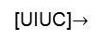
Multiply Using One Thread Block
One Block of threads computes matrix P
Each thread computes one element of P
Each thread does a dot product
Loads a row of matrix M
Loads a column of matrix N
Perform one multiply and addition for each pair of M and N elements
Compute to off-chip memory access ratio close to 1:1
Not that good…
Size of matrix limited by the number of threads allowed in a thread block
Grid 1
N
Block 1
Thread
(2, 2)
48
M
P
width
[UIUC]$→$
Notes:
Low arithmetic intensity! We’ll come back to this (shared memory)

Slide 53
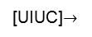
Matrix Multiplication: sequential approach, coded in C
// Matrix multiplication on the (CPU) host in double precision;
void MatrixMulOnHost(const Matrix M, const Matrix N, Matrix P)
{
for (int i = 0; i < M.height; ++i) {
for (int j = 0; j < N.width; ++j) {
double sum = 0;
for (int k = 0; k < M.width; ++k) {
double a = M.elements[i * M.width + k]; //march along a row of M
double b = N.elements[k * N.width + j]; //march along a column of N
sum += a * b;
}
P.elements[i * N.width + j] = sum;
}
}
}
[UIUC]$→$
Notes:
On the CPU, you need 3 loops.
On the GPU, we do not need the 2 outer loops.
Note the stride 1 when reading in a row, but width when reading in a column

Slide 54
Step 1: Matrix Multiplication, Host-side. Main Program Code
int main(void) {
// Allocate and initialize the matrices.
// The last argument in AllocateMatrix: should an initialization with
// random numbers be done? Yes: 1. No: 0 (everything is set to zero)
Matrix M = AllocateMatrix(WIDTH, WIDTH, 1);
Matrix N = AllocateMatrix(WIDTH, WIDTH, 1);
Matrix P = AllocateMatrix(WIDTH, WIDTH, 0);
// M * N on the device
MatrixMulOnDevice(M, N, P);
// Free matrices
FreeMatrix(M);
FreeMatrix(N);
FreeMatrix(P);
return 0;
}
[UIUC]$→$

Slide 55
Step 2: Matrix Multiplication [host-side code]
void MatrixMulOnDevice(const Matrix M, const Matrix N, Matrix P)
{
// Load M and N to the device
Matrix Md = AllocateDeviceMatrix(M);
CopyToDeviceMatrix(Md, M);
Matrix Nd = AllocateDeviceMatrix(N);
CopyToDeviceMatrix(Nd, N);
// Allocate P on the device
Matrix Pd = AllocateDeviceMatrix(P);
// Setup the execution configuration
dim3 dimGrid(1, 1, 1);
dim3 dimBlock(WIDTH, WIDTH);
// Launch the kernel on the device
MatrixMulKernel<<<dimGrid, dimBlock>>>(Md, Nd, Pd);
// Read P from the device
CopyFromDeviceMatrix(P, Pd);
// Free device matrices
FreeDeviceMatrix(Md);
FreeDeviceMatrix(Nd);
FreeDeviceMatrix(Pd);
}
[UIUC]$→$

Slide 56
Step 3: Matrix Multiplication - Device-side Kernel Function
// Matrix multiplication kernel – thread specification
__global__ void MatrixMulKernel(Matrix M, Matrix N, Matrix P) {
// 2D Thread Index; computing P[ty][tx]…
int tx = threadIdx.x;
int ty = threadIdx.y;
// Pvalue will end up storing the value of P[ty][tx].
// That is, P.elements[ty * P. width + tx] = Pvalue
float Pvalue = 0;
for (int k = 0; k < M.width; ++k) {
float Melement = M.elements[ty * M.width + k];
float Nelement = N.elements[k * N. width + tx];
Pvalue += Melement * Nelement;
}
// Write matrix to device memory; each thread one element
P.elements[ty * P. width + tx] = Pvalue;
}
N
WIDTH
M
P
tx
WIDTH
Note: Pvalue is a local value; stored in a register. Access global memory once at the very end
ty
WIDTH
WIDTH
Notes:
Discuss why we have the local variable Pvalue
if we updated directly into the desired entry of P, we would make trips to global memory at each iteration
Pvalue declared here is local (and stored in a register)
we make a single trip to global memory to deposit the aggregate Pvalue
Note: a similar “trick” used in CPU code. There it has to do with not trashing the cache.

Slide 57
Step 4: Some Loose Ends
// Allocate a device matrix of same size as M.
Matrix AllocateDeviceMatrix(const Matrix M) {
Matrix Mdevice = M;
int size = M.width * M.height * sizeof(float);
cudaMalloc((void**)&Mdevice.elements, size);
return Mdevice;
}
// Copy a host matrix to a device matrix.
void CopyToDeviceMatrix(Matrix Mdevice, const Matrix Mhost) {
int size = Mhost.width * Mhost.height * sizeof(float);
cudaMemcpy(Mdevice.elements, Mhost.elements, size, cudaMemcpyHostToDevice);
}
// Copy a device matrix to a host matrix.
void CopyFromDeviceMatrix(Matrix Mhost, const Matrix Mdevice) {
int size = Mdevice.width * Mdevice.height * sizeof(float);
cudaMemcpy(Mhost.elements, Mdevice.elements, size, cudaMemcpyDeviceToHost);
}
// Free a device matrix.
void FreeDeviceMatrix(Matrix M) {
cudaFree(M.elements);
}
void FreeMatrix(Matrix M) {
free(M.elements);
}
[UIUC]$→$
Notes:
QUESTION: why is the 1st argument of cudaMalloc a void**? Must return a pointer
Note: The C malloc returns by return value, not through an argument! So, it can have a signature void *malloc(size_t size)

Slide 58
Before Moving On… [Some Words of Wisdom]
In GPU computing you use as many threads as data items (tasks, jobs) you have to perform
This replaces the purpose in life of the “for” loop
Number of threads & blocks is established at run-time
In many cases, the rule is Number of threads = Number of data items
You’ll have to come up with a rule to match a thread to data item that this thread needs to process
Most common source of errors and frustration in GPU computing
It never fails to deliver (frustration)
:-(
Notes:
RECALL: make sure you do not access outside of bounds.
Always, check the thread ID against the data size.
Mapping threads <-> work is a recurring theme in CUDA programming. Important to do it right! Frustrating arithmetic and logic.

Slide 59
CUDA, Another Example (1/2)
Multiply, pairwise, two arrays of 3 million integers
int main(int argc, char* argv[])
{
const int arraySize = 3000000;
int *hA, *hB, *hC;
setupHost(&hA, &hB, &hC, arraySize);
int *dA, *dB, *dC;
setupDevice(&dA, &dB, &dC, arraySize);
cudaMemcpy(dA, hA, sizeof(int) * arraySize, cudaMemcpyHostToDevice);
cudaMemcpy(dB, hB, sizeof(int) * arraySize, cudaMemcpyHostToDevice);
const int threadsPerBlock = 512;
const int blocksPerGrid = (arraySize + threadsPerBlock – 1)/threadsPerBlock;
multiply_ab<<<blocksPerGrid, threadsPerBlock>>>(dA, dB, dC, arraySize);
cudaMemcpy(hC, dC, sizeof(int) * arraySize, cudaMemcpyDeviceToHost);
cleanupHost(hA, hB, hC);
cleanupDevice(dA, dB, dC);
return 0;
}
Notes:
Why do we use:
blocksPerGrid = arraySize/threadsPerBlock + 1 ?
Is this the best way to calculate the blockSize? NO
What happens if we have arraySize = 1024?
How many blocks do we need? 2
How many do we actually configure? 3
Better:
blocksPerGrid = (arraySize + threadsPerBlock – 1) / threadsPerBlock

Slide 60
CUDA, Another Example (2/2)
__global__ void multiply_ab(int* a, int* b, int* c, int size)
{
int whichEntry = threadIdx.x + blockIdx.x * blockDim.x;
if( whichEntry<size )
c[whichEntry] = a[whichEntry] * b[whichEntry];
}
void setupDevice(int** pdA, int** pdB, int** pdC, int arraySize)
{
cudaMalloc((void**) pdA, sizeof(int) * arraySize);
cudaMalloc((void**) pdB, sizeof(int) * arraySize);
cudaMalloc((void**) pdC, sizeof(int) * arraySize);
}
void cleanupDevice(int *dA, int *dB, int *dC)
{
cudaFree(dA);
cudaFree(dB);
cudaFree(dC);
}
Notes:
Kernel: sequence of steps that a thread performs
Discuss the mapping from thread index to task

Slide 61
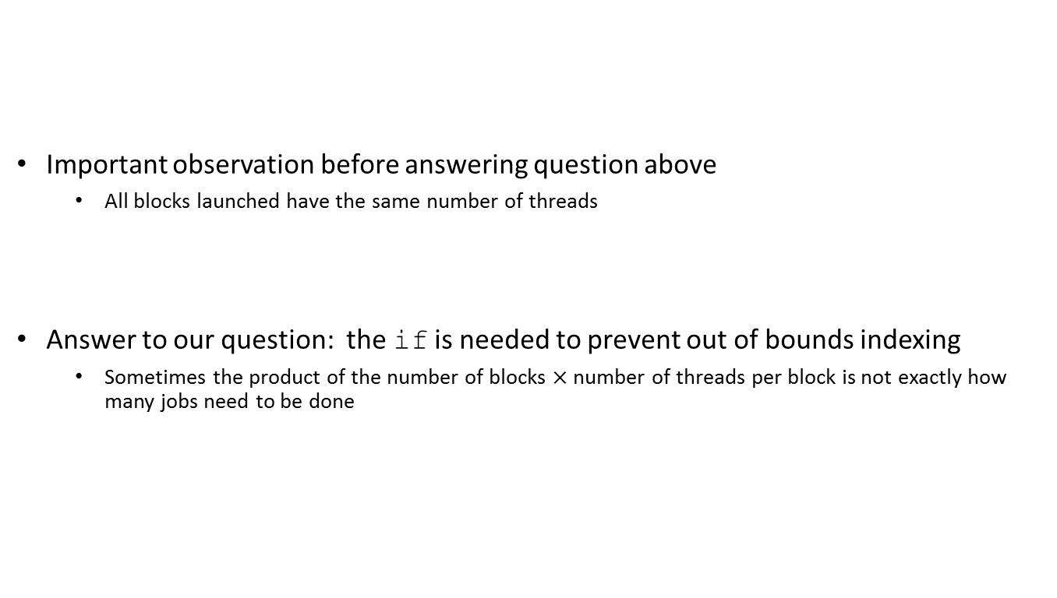
if( whichEntry<size ): Why Do I Need this Test?
Important observation before answering question above
All blocks launched have the same number of threads
Answer to our question: the if is needed to prevent out of bounds indexing
Sometimes the product of the number of blocks $×$ number of threads per block is not exactly how many jobs need to be done

Slide 62
Execution Configuration Related
Assume arrays of 1493 elements (instead of 3000000)
Largest CUDA block that you can get has 1024 threads
Also, 1493 is a prime number
You’ll have to use at least two CUDA blocks of threads
Perhaps you want to use three blocks of 512 each…
You’ll have some threads that do no work (there’ll be an if statement in there)
Problem becomes more interesting in two dimension when you have square blocks to pad a matrix and end up overshooting in two directions

Slide 63
1493 entries in 1D array
You are overshooting here, some threads do no work
Block 0: 512 threads
Block 1: 512 threads
Block 2: 512 threads
1D Example
You are overshooting here
Block 16 by 16
Block 16 by 16
Block 16 by 16
Block 16 by 16
Block 16 by 16
Block 16 by 16
2D Example
Block 16 by 16
Block 16 by 16
Block 16 by 16
Block 16 by 16
Block 16 by 16
Block 16 by 16
You are overshooting here as well

Slide 64
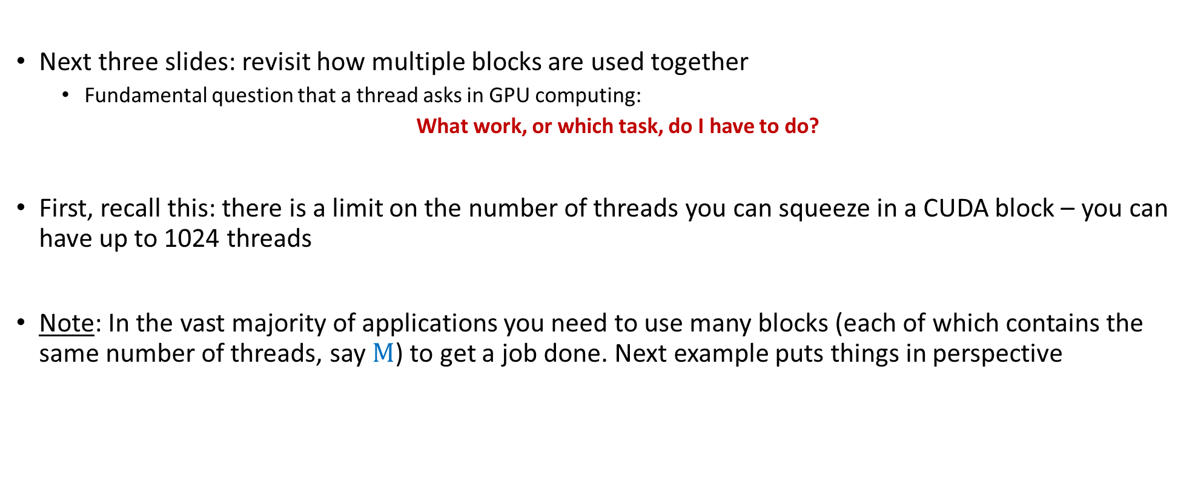
Array Indexing Issues
Next three slides: revisit how multiple blocks are used together
Fundamental question that a thread asks in GPU computing:
What work, or which task, do I have to do?
First, recall this: there is a limit on the number of threads you can squeeze in a CUDA block – you can have up to 1024 threads
Note: In the vast majority of applications you need to use many blocks (each of which contains the same number of threads, say $M$) to get a job done. Next example puts things in perspective

Slide 65
Array Indexing Demo: The multi-block case
[Important to grasp: shows thread-to-task mapping]
Multiple blocks – you will likely be using more than just threadIdx.x
Consider indexing into an 1D array, one thread accessing one element
Assume you have M=8 threads per block and the array is 32 entries long
threadIdx.x
threadIdx.x
threadIdx.x
threadIdx.x
0
1
2
3
4
5
6
7
0
1
2
3
4
5
6
7
0
1
2
3
4
5
6
7
0
1
2
3
4
5
6
7
blockIdx.x = 0
blockIdx.x = 1
blockIdx.x = 2
blockIdx.x = 3
With M threads per 1D CUDA block, the array index that a thread works on is:
int index = threadIdx.x + blockIdx.x * M;
[NVIDIA]→
Notes:
Made up example, where a block can only have 8 threads, but we want to process an array with 32 entries.
0 <= threadIdx.x <= 7
What thread works on entry 21?
Identical to finding offset in 1-dimensional storage of a 2-dimensional matrix:
int index = x + width * y;

Slide 66
Example: Array Indexing
1
2
3
4
5
6
7
8
9
10
11
12
13
14
15
16
17
18
19
20
21
22
23
24
25
26
27
28
29
30
0
31
What is the array index that thread of index 5 in block of index 2 will work on?
M = 8
threadIdx.x = 5
0
1
2
3
4
5
6
7
0
1
2
3
4
5
6
7
0
1
2
3
4
5
6
7
0
1
2
3
4
5
6
7
blockIdx.x = 2
int index = threadIdx.x + blockIdx.x * M;
= 5 + 2 * 8;
= 21;
0
1
2
3
4
5
6
7
8
9
10
11
12
13
14
15
16
17
18
19
20
21
22
23
24
25
26
27
28
29
30
31
[NVIDIA]→
Notes:
In general, the work of a thread is what you would have inside a for loop (but no need for the loop itself)!

Slide 67
Recurring Theme in CUDA Programming [summarizing previous discussion, started after CUDA Example]
Imagine you are one of many threads; you have your thread index & block index
Two things need to be addressed
You need to figure out the work, or the job, you need to take care of
Just like we did on previous slide, where thread 5 in block 2 realized it needed to work on entry 21
You have to make sure you actually need to do that work
In many problems there are threads that need not do any work
Example: you launch 2 blocks with 512 threads; your array is only 1000 elements long; 24 threads at the end might do nothing
“24 threads at the end might do nothing” – depending on the implementation

Slide 68
[short topic]: Timing Your Application
Timing support – part of the CUDA API
You pick it up as soon as you include <cuda.h>
Provides cross-platform compatibility
Deals with the asynchronous nature of the device calls by relying on events and forced synchronization
Reports time in milliseconds, accurate within 0.5 microseconds
From NVIDIA CUDA Library Documentation:
Computes the elapsed time between two events (in milliseconds with a resolution of around 0.5 microseconds). If either event has not been recorded yet, this function returns cudaErrorInvalidValue. If either event has been recorded with a non-zero stream, the result is undefined.

Slide 69
Timing Example: timing a GPU call
#include<iostream>
#include<cuda.h>
int main() {
cudaEvent_t startEvent, stopEvent;
cudaEventCreate(&startEvent);
cudaEventCreate(&stopEvent);
cudaEventRecord(startEvent, 0);
yourKernelCallComesHere<<<NumBlk,NumThrds>>>(args);
cudaEventRecord(stopEvent, 0);
cudaEventSynchronize(stopEvent);
float elapsedTime;
cudaEventElapsedTime(&elapsedTime, startEvent, stopEvent);
std::cout << "Time to get device properties: " << elapsedTime << " ms\n";
cudaEventDestroy(startEvent);
cudaEventDestroy(stopEvent);
return 0;
}
Notes:
RECALL: asynchronous execution on the GPU
You cannot use timing on the host! That would give you garbage.
Need cudaEventSynchronize to wait for that event to complete.
But we only need this for the stopEvent
Indeed, the CUDA operations on the GPU execute in order, so no need to “synchronize” the startEvent

